Slide 1

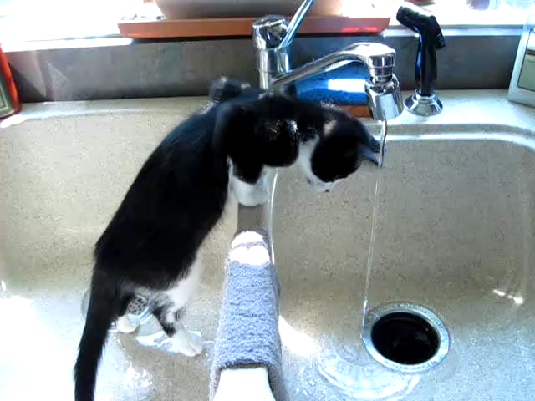

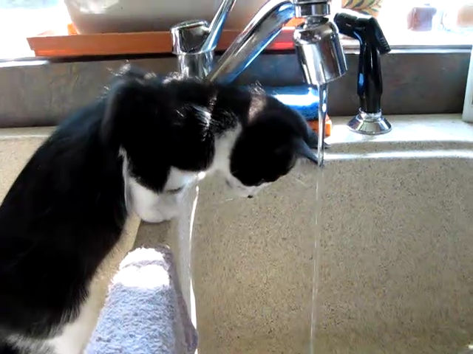
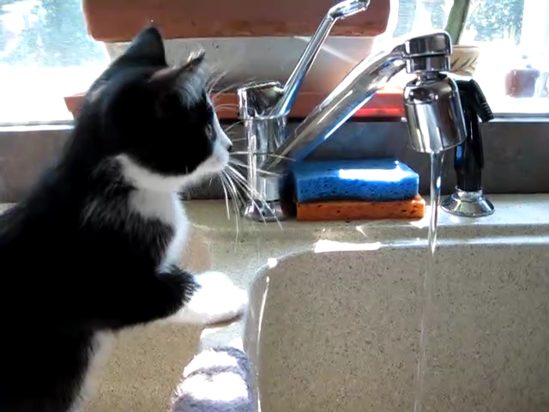
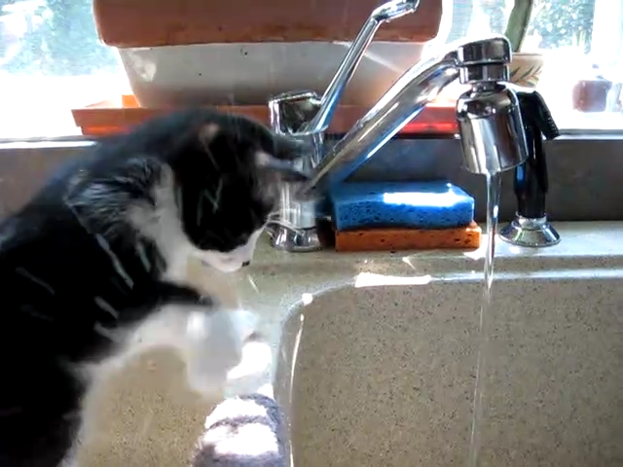
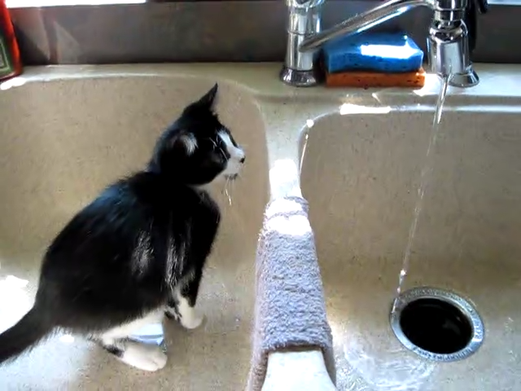

Question: Why is the cat shaking its paws after moving back?
Video: Candidates:
1. to remove water from his body
2. sleepy
3. prevent hitting shelf
4. swat water from face
5. injured
VLM Frame Selection
[Image] Selected Frames
[Text] Question and Candidates
[Text] Global Object Information [Text] Object Spatial Location [Text] Object Motion Trajectory
Selected Frames
Object Detection
Image 1: 1. Cat, 2. Sink, …
Image 2: 1. Cat, 2. Window…
Image 3: …
Template
Operations
VLM
Log-Likelihood Selection
Per Frame Object List
Object Matching
Object Trajectories
Cat: [x1, y1], [x2, y2], [], [], …
Sink: [], [], [], [], …
swat water from face

Slide 2
Question: Why is the cat shaking its paws after moving back?
Video: Candidates:
1. to remove water from his body
2. sleepy
3. prevent hitting shelf
4. swat water from face
5. injured
VLM Frame Selection
[Text] Question and Candidates
[Image] Selected Frames
[Text] Global Object Information [Text] Object Spatial Location [Text] Object Motion Trajectory
Selected Frames
Object Detection
Per Frame
Object List
Image 1: 1. Cat, 2. Sink, …
Image 2: 1. Cat, 2. Window…
Image 3: …
Template
Operations
VLM
Log-Likelihood Selection
Object Matching
Object Trajectories
Cat: [x1, y1], [x2, y2], [], [], …
Sink: [], [], [], [], …
swat water from face

Slide 3
Question: Why is the cat shaking its paws after moving back?
Video: Candidates:
C1. to remove water from his body
C2. sleepy
C3. prevent hitting shelf
C4. swat water from face
C5. injured
[Text] Question and Candidates
[Image] Selected Frames
[Text] Global Object Information [Text] Object Spatial Location [Text] Object Motion Trajectory
VLM Frame Selection
Selected Frames
Object Detection
Per Frame
Object List
Image 1: 1. Cat, 2. Sink, …
Image 2: 1. Cat, 2. Window…
Image 3: …
Template
Operations
VLM
Log-Likelihood Selection
Object Matching
Object Trajectories
Cat: [x1, y1], [x2, y2], [], [], …
Sink: [], [], [], [], …
swat water from face

Slide 4
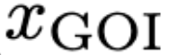
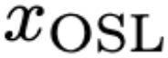
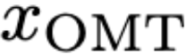
Question: Why is the cat shaking its paws after moving back?
Video: Candidates:
C1. to remove water from his body
C2. sleepy
C3. prevent hitting shelf
C4. swat water from face
C5. injured
💬 Question and Candidates
VLM Frame Selection
Selected Frames
Object Detection
Template Operations
VLM
(LLaVA-1.5 13B)
Log-Likelihood Selection
Per Frame
Object List
Image 1: 1. Cat, 2. Sink, …
Image 2: 1. Cat, 2. Window…
Image 3: …
🖼️ Selected Frames
💬 Global Object Information 💬 Object Spatial Location 💬 Object Motion Trajectory
Object Matching
Object Trajectories
Cat: [x1, y1], [x2, y2], [], [], …
Sink: [], [], [], [], …
C1 C2 C3 C4 C5
swat water from face

Slide 5
Question: Why is the cat shaking its paws after moving back?
Video: Candidates:
C1. to remove water from his body
C2. sleepy
C3. prevent hitting shelf
C4. swat water from face
C5. injured
💬 Question and Candidates
VLM Frame Selection
Selected Frames
Object Detection
Template Operations
VLM
(LLaVA-1.5 13B)
Log-Likelihood Selection
Per Frame
Object List
Image 1: 1. Cat, 2. Sink, …
Image 2: 1. Cat, 2. Window…
Image 3: …
🖼️ Selected Frames
💬 Global Object Information 💬 Object Spatial Location 💬 Object Motion Trajectory
Object Matching
C1 C2 C3 C4 C5
Object Trajectories
Cat: [x1, y1], [x2, y2], [], [], …
Sink: [], [], [], [], …
swat water from face

Slide 6
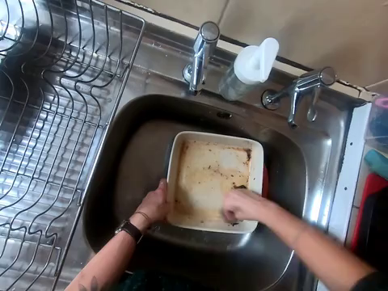
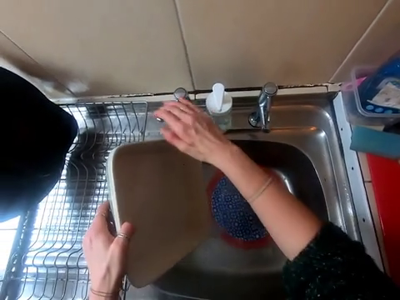
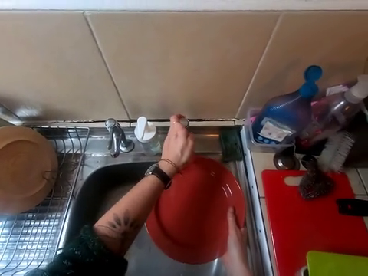
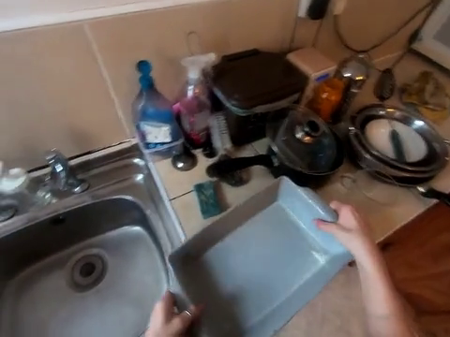

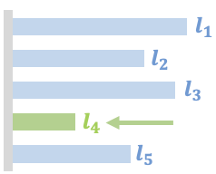
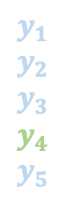

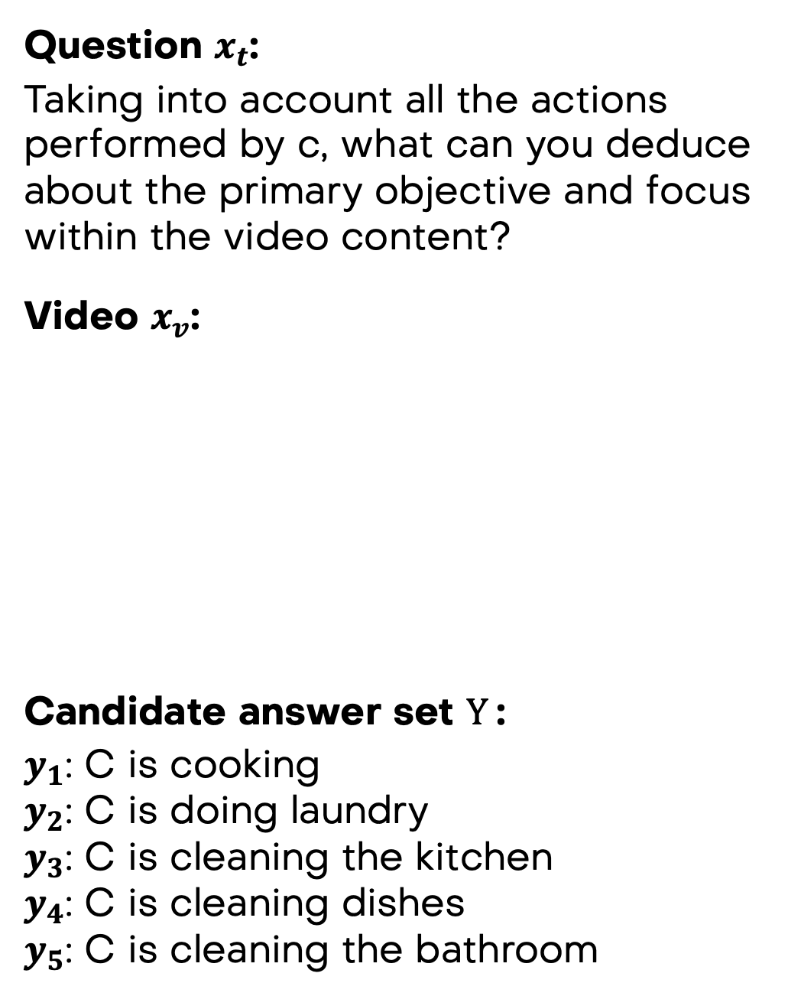

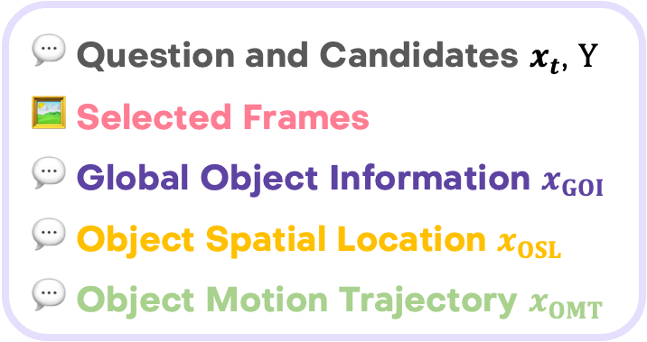
Question $x_{t}$:
Taking into account all the actions performed by c, what can you deduce about the primary objective and focus within the video content?
Video $x_{v}$:
Candidate answer set $Y$:
$y_{1}$: C is cooking
$y_{2}$: C is doing laundry
$y_{3}$: C is cleaning the kitchen
$y_{4}$: C is cleaning dishes
$y_{5}$: C is cleaning the bathroom
VLM Frame Selection
MVU
Per Frame Object Detection
Template Operations
VLM with
Likelihood Selection
hand located at (0.39, 0.7)
dish located at (0.55, 0.62)
…
💬 Question and Candidates $x_{t}$, $Y$
🖼️ Selected Frames
💬 Global Object Information $x_{GOI}$ 💬 Object Spatial Location $x_{OSL}$ 💬 Object Motion Trajectory $x_{OMT}$
$$l_{i}$$
$$y_{1}$$
$$y_{2}$$
$$y_{3}$$
$$y_{4}$$
$$y_{5}$$
Object Matching
hand trajectory: (0.39,0.7,0.02)-> …
dish trajectory: (0.55,0.62,0.096)-> …
…
$\hat{y}$: C is cleaning dishes

Slide 7
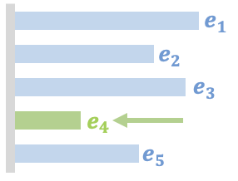
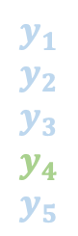
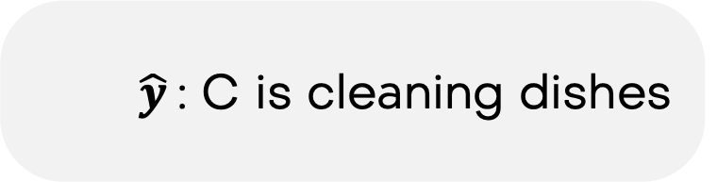

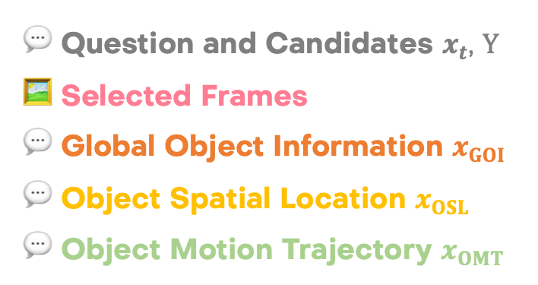
Question $x_{t}$:
Taking into account all the actions performed by c, what can you deduce about the primary objective and focus within the video content?
Video $x_{v}$:
Candidate answer set $Y$:
$y_{1}$: C is cooking
$y_{2}$: C is doing laundry
$y_{3}$: C is cleaning the kitchen
$y_{4}$: C is cleaning dishes
$y_{5}$: C is cleaning the bathroom
VLM Frame Selection
MVU
Per Frame Object Detection
Template Operations
VLM Answer Selection
💬 Question and Candidates $x_{t}$, $Y$
🖼️ Selected Frames
💬 Global Object Information $x_{GOI}$ 💬 Object Spatial Location $x_{OSL}$ 💬 Object Motion Trajectory $x_{OMT}$
hand located at (0.39, 0.7)
dish located at (0.55, 0.62)
…
$$e_{i}$$
$$y_{1}$$
$$y_{2}$$
$$y_{3}$$
$$y_{4}$$
$$y_{5}$$
Object Matching
hand trajectory: (0.39,0.7,0.02)-> …
dish trajectory: (0.55,0.62,0.096)-> …
…
$\hat{y}$: C is cleaning dishes

Slide 8
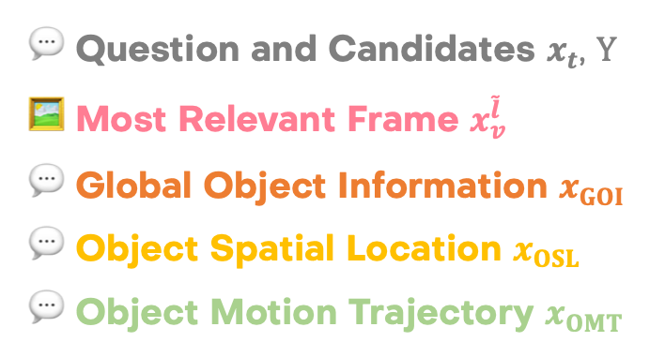
Question $x_{t}$:
Taking into account all the actions performed by c, what can you deduce about the primary objective and focus within the video content?
Video $x_{v}$:
Candidate answer set $Y$:
$y_{1}$: C is cooking
$y_{2}$: C is doing laundry
$y_{3}$: C is cleaning the kitchen
$y_{4}$: C is cleaning dishes
$y_{5}$: C is cleaning the bathroom
VLM Frame Selection
MVU
Per Frame Object Detection
Template Operations
VLM Answer Selection
hand located at (0.39, 0.7, 0.02)
dish located at (0.55, 0.62, 0.096) …
💬 Question and Candidates $x_{t}$, $Y$
🖼️ Most Relevant Frame $x_{v}^{\tilde{l}}$
💬 Global Object Information $x_{GOI}$ 💬 Object Spatial Location $x_{OSL}$ 💬 Object Motion Trajectory $x_{OMT}$
$$e_{i}$$
$$y_{1}$$
$$y_{2}$$
$$y_{3}$$
$$y_{4}$$
$$y_{5}$$
Object Matching
hand trajectory: (0.39,0.7,0.02)-> …
dish trajectory: (0.55,0.62,0.096)-> …
$\hat{y}$: C is cleaning dishes

Slide 9
💬 Question
💬 Candidates
LLM
Selected Answer
🖼️ Multi. Frames
. . .
MVU
Vid-LLM
💬 Global Object Information
💬 Object Spatial Location .
💬 Object Motion Trajectory .
🖼️ Single Frame
VLM
Selected Answer
Selected Answer
💬 Question
💬 Candidates
💬 Question
💬 Candidates
Vid-VLM
Multi-Modal Video Framework
Question: Why is the cat shaking its paws after moving back?
Video:
Candidates:
C1. to remove water from his body
C2. sleepy
C3. prevent hitting shelf
C4. swat water from face
C5. injured

Slide 10
🖼️ Image
X
LLM
🤖 Answer using Likelihood Selection
🖼️ Selected Frames
VLM
💬 Question
💬 Candidates
Just LLM
🎞️ Video
💬 Global Object Information
💬 Object Spatial Location
💬 Object Motion Trajectory
🖼️ Single Frame
VLM
🤖 Answer using Likelihood Selection
🤖 Answer using Likelihood Selection
💬 Question
💬 Candidates
💬 Question
💬 Candidates
Single Frame VLM
Multimodal Video Understanding (MVU)

Slide 11

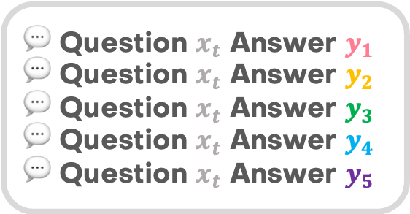
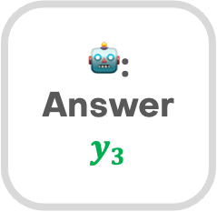
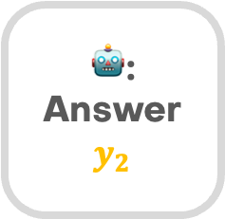
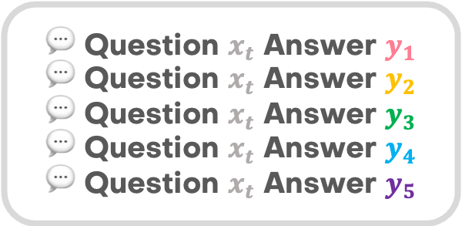
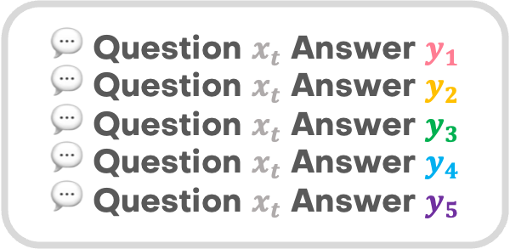
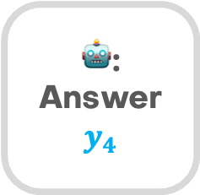
🎞️ Video
X
LLM
Cross Entropy
Loss
💬
💬
💬
💬
💬
🎞️ Video
🖼️ Most Relevant Frame
VLM
💬 Question $x_{t}$ Answer $y_{1}$
💬 Question $x_{t}$ Answer $y_{2}$
💬 Question $x_{t}$ Answer $y_{3}$
💬 Question $x_{t}$ Answer $y_{4}$
💬 Question $x_{t}$ Answer $y_{5}$
🤖: Answer $$y_{2}$$
🖼️ Frames selected by VLM
Cross Entropy
Loss
💬
💬
💬
💬
💬
Just LLM
🤖: Answer $$y_{4}$$
🎞️ Video
🖼️ Mid Frame
VLM
Cross Entropy
Loss
💬
💬
💬
💬
💬
💬 Global Object Information 💬 Object Spatial Location 💬 Object Motion Trajectory
💬 Question $x_{t}$ Answer $y_{1}$
💬 Question $x_{t}$ Answer $y_{2}$
💬 Question $x_{t}$ Answer $y_{3}$
💬 Question $x_{t}$ Answer $y_{4}$
💬 Question $x_{t}$ Answer $y_{5}$
🤖: Answer $$y_{3}$$
💬 Question $x_{t}$ Answer $y_{1}$
💬 Question $x_{t}$ Answer $y_{2}$
💬 Question $x_{t}$ Answer $y_{3}$
💬 Question $x_{t}$ Answer $y_{4}$
💬 Question $x_{t}$ Answer $y_{5}$
Single Frame VLM
Multimodal Video Understanding (MVU)

Slide 12
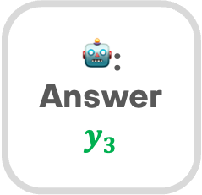
🎞️ Video
X
LLM
Likelihood Selection
🎞️ Video
🖼️ Most Relevant Frame
VLM
Cross Entropy
Loss
💬
💬
💬
💬
💬
🤖: Answer $$y_{2}$$
💬 Question $x_{t}$ Answer $y_{1}$
💬 Question $x_{t}$ Answer $y_{2}$
💬 Question $x_{t}$ Answer $y_{3}$
💬 Question $x_{t}$ Answer $y_{4}$
💬 Question $x_{t}$ Answer $y_{5}$
🖼️ Frames selected by VLM
Likelihood Selection
Cross Entropy
Loss
💬
💬
💬
💬
💬
🤖: Answer $$y_{4}$$
Just LLM
🎞️ Video
🖼️ Mid Frame
VLM
Likelihood Selection
💬 Global Object Information 💬 Object Spatial Location 💬 Object Motion Trajectory
Cross Entropy
Loss
💬
💬
💬
💬
💬
🤖: Answer $$y_{3}$$
💬 Question $x_{t}$ Answer $y_{1}$
💬 Question $x_{t}$ Answer $y_{2}$
💬 Question $x_{t}$ Answer $y_{3}$
💬 Question $x_{t}$ Answer $y_{4}$
💬 Question $x_{t}$ Answer $y_{5}$
💬 Question $x_{t}$ Answer $y_{1}$
💬 Question $x_{t}$ Answer $y_{2}$
💬 Question $x_{t}$ Answer $y_{3}$
💬 Question $x_{t}$ Answer $y_{4}$
💬 Question $x_{t}$ Answer $y_{5}$
Single Frame VLM
Multimodal Video Understanding (MVU)

Slide 13





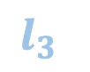


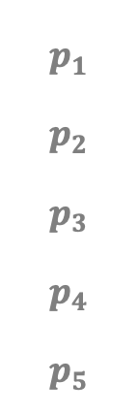


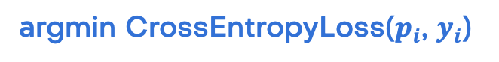

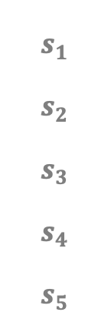

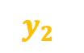


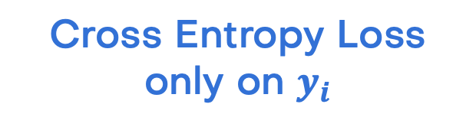
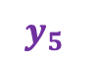

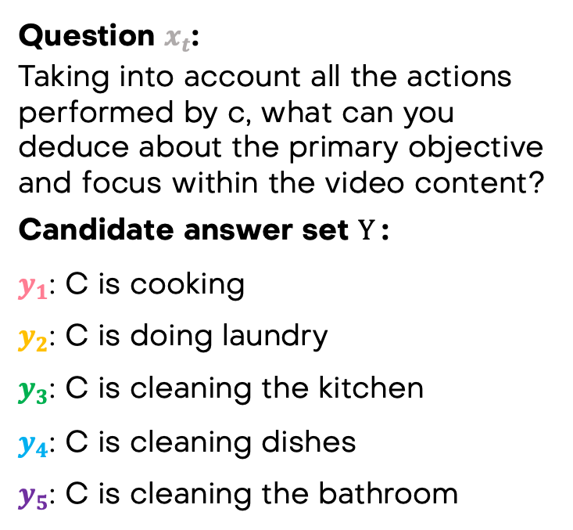


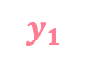



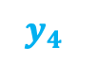




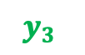
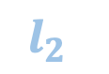


Question $x_{t}$:
Taking into account all the actions performed by c, what can you deduce about the primary objective and focus within the video content?
Candidate answer set $Y$:
$y_{1}$: C is cooking
$y_{2}$: C is doing laundry
$y_{3}$: C is cleaning the kitchen
$y_{4}$: C is cleaning dishes
$y_{5}$: C is cleaning the bathroom
Batch
Predicted Logits
Cross Entropy Loss
only on $y_{i}$
$$s_{1}$$
$$s_{2}$$
$$s_{3}$$
$$s_{4}$$
$$s_{5}$$
$$x_{t}$$
$$y_{1}$$
$$p_{1}$$
$$p_{2}$$
$$p_{3}$$
$$p_{4}$$
$$p_{5}$$
$$l_{i}$$
argmin CrossEntropyLoss($p_{i}$, $y_{i}$)
$$x_{t}$$
$$y_{2}$$
LLM / VLM
Single Pass w/ Mask
$$x_{t}$$
$$y_{1}$$
$$y_{i}∈Y$$
$$x_{t}$$
$$y_{3}$$
$$x_{t}$$
$$y_{2}$$
$$l_{2}$$
$$l_{5}$$
$$x_{t}$$
$$y_{4}$$
$$x_{t}$$
$$y_{3}$$
$$l_{1}$$
$$l_{3}$$
$$x_{t}$$
$$y_{5}$$
$$x_{t}$$
$$y_{4}$$
$$l_{4}$$
$$x_{t}$$
$$y_{5}$$
$$y_{1}$$
$$y_{2}$$
$$y_{3}$$
$$y_{4}$$
$$y_{5}$$

Slide 14





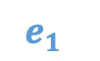


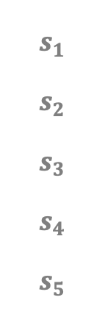
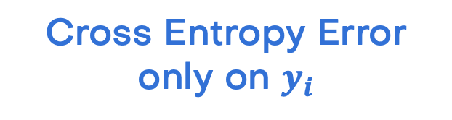
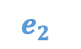
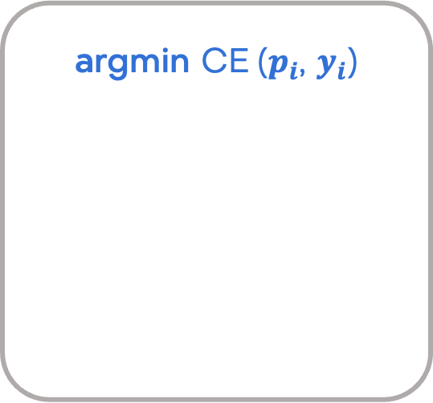


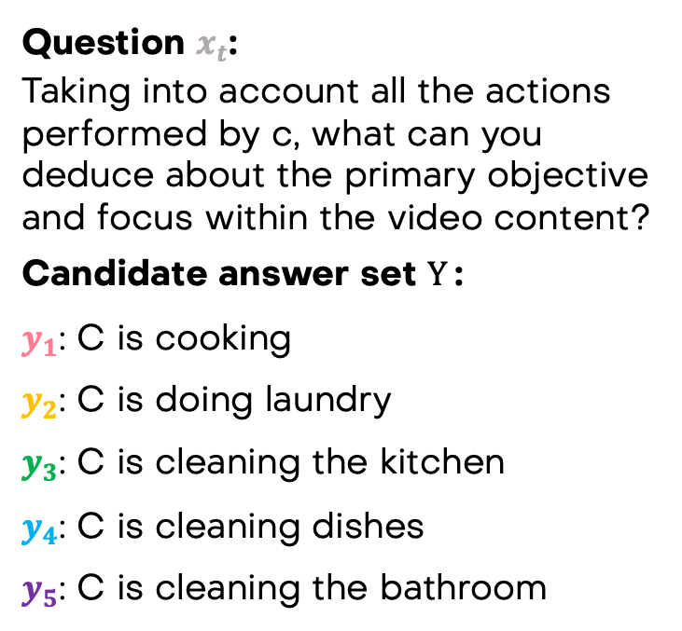


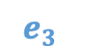






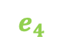





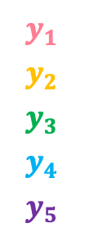
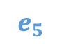

Question $x_{t}$:
Taking into account all the actions performed by c, what can you deduce about the primary objective and focus within the video content?
Candidate answer set $Y$:
$y_{1}$: C is cooking
$y_{2}$: C is doing laundry
$y_{3}$: C is cleaning the kitchen
$y_{4}$: C is cleaning dishes
$y_{5}$: C is cleaning the bathroom
Batch
Predicted Logits
Cross Entropy Error
only on $y_{i}$
argmin $\text{CE} \text{(}p_{i}\text{, }y_{i}\text{)}$
$$s_{1}$$
$$s_{2}$$
$$s_{3}$$
$$s_{4}$$
$$s_{5}$$
$$x_{t}$$
$$y_{1}$$
$$p_{1}$$
$$p_{2}$$
$$p_{3}$$
$$p_{4}$$
$$p_{5}$$
$$e_{i}$$
$$y_{i}∈Y$$
$$x_{t}$$
LLM / VLM
Single Pass w/ Mask
$$x_{t}$$
$$y_{1}$$
$$y_{1}$$
$$y_{2}$$
$$y_{3}$$
$$y_{4}$$
$$y_{5}$$
$$e_{2}$$
$$e_{1}$$
$$x_{t}$$
$$y_{2}$$
$$e_{3}$$
$$x_{t}$$
$$y_{3}$$
$$x_{t}$$
$$y_{2}$$
$$e_{4}$$
$$e_{5}$$
$$x_{t}$$
$$y_{4}$$
$$x_{t}$$
$$y_{3}$$
$$y_{5}$$
$$x_{t}$$
$$y_{4}$$
$$x_{t}$$
$$y_{5}$$
C is cleaning dishes

Slide 15















